Slide 1
London Funders Member Audit 2020/21

Slide 2
London Funders survey
Third annual survey mapping how much, where and what members have funded
58% of members completed the survey

Slide 3
Where do our funders reach?
Notes:
This is all members not survey.
Of London Funders’ 172 members (at time survey went out), 99 responded, a response rate of 58%.

Slide 4
Process & response rate

Slide 5
Types of Funding

Slide 6
What funders are expecting to happen to their grantmaking this FY

Slide 7
Are funders using the 360 data standard?
Notes:
55% responded no, there were a mix of local and national organisations

Slide 8
Types of funding
Notes:
37% of London Funders’ members offer revenue funding, with 15% offering capital funding.

Slide 9
Amount distributed each year by members
Notes:
31% of respondents give out less than £500K each year

Slide 10
Do funders see their funding approach as proactive or responsive?
Notes:
73% of members see themselves as both proactive and reactive funders

Slide 11
How interested are funders in collaborating with other funders?
Notes:
No respondents stated they were not interested in collaboration

Slide 12
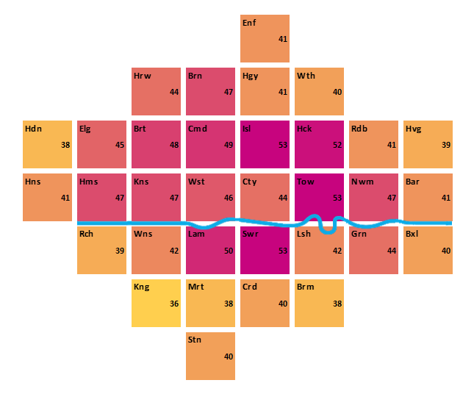
Where did funders fund in 2020/21?
Notes:
57% of respondents said they can fund in all boroughs, only 32% of respondents did fund in all boroughs

Slide 13
Compared to 2019/20

Slide 14
What did funders fund?
Notes:
The theme which most respondents said they worked on was health and social care (56), followed by crisis and poverty (54). Fewest respondents worked on research (15), general charitable purposes (27) and the environment (32).
Within health and social care, mental health was the largest sub-theme, with 51 respondents working in this area, compared to 36 for physical health.

Slide 15
What people/communities?
Notes:
Looking at the people and communities they support, most respondents work with children and young people, with fewest working specifically with faith groups, men and LGBTQ+.

